Slide 1


Deep Learning for Natural Language Processing DLNLP 14: Encoder-decoder Methods
Mihai Surdeanu and Marco A. Valenzuela-Escárcega

Slide 2
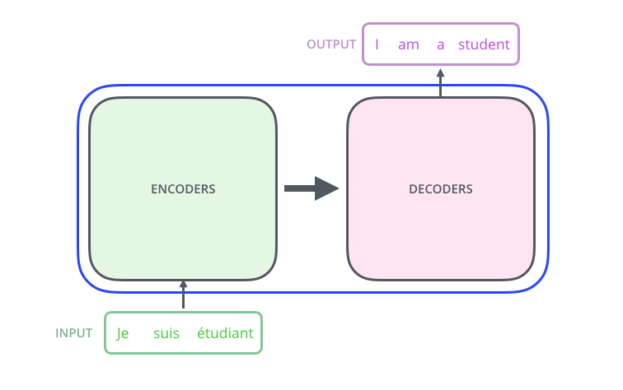
Overview
This lecture
Slide from http://jalammar.github.io/illustrated-transformer/

Slide 3
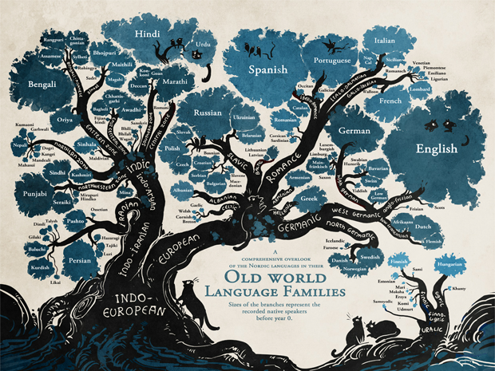
Motivation
Machine translation and chat bots!

Slide 4
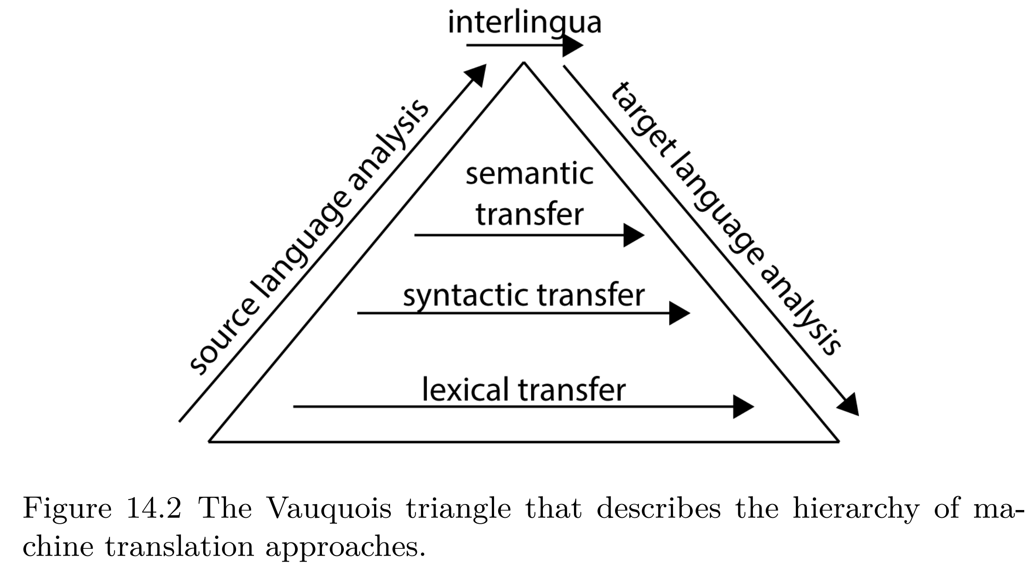
Vauquois triangle for machine translation

Slide 5

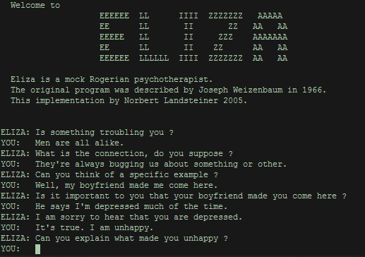
Chat bots

Slide 6
Overview
Evaluation measure (BLUE)
The first sequence-to-sequence architecture using LSTMs
Sequence-to-sequence with attention
Transformer-based encoder-decoder architectures

Slide 7
Evaluation measures

Slide 8
What are we evaluating?
Slide from http://jalammar.github.io/illustrated-transformer/

Slide 9
BLEU (bilingual evaluation understudy)
BLEU measures the word overlap between a candidate translation produced by the machine and a reference translation
BLUE “counts up the number of candidate translation words (unigrams) which occur in any reference translation and then divides by the total number of words in the candidate translation” (Papineni et al., 2002)

Slide 10
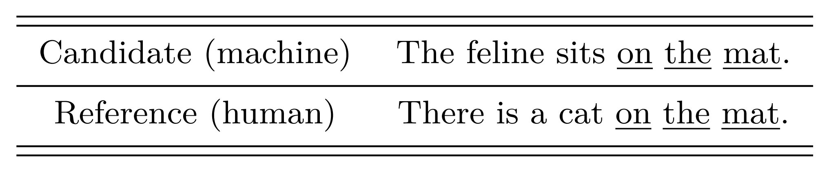
BLUE example
What is the BLUE score of the candidate translation?

Slide 11
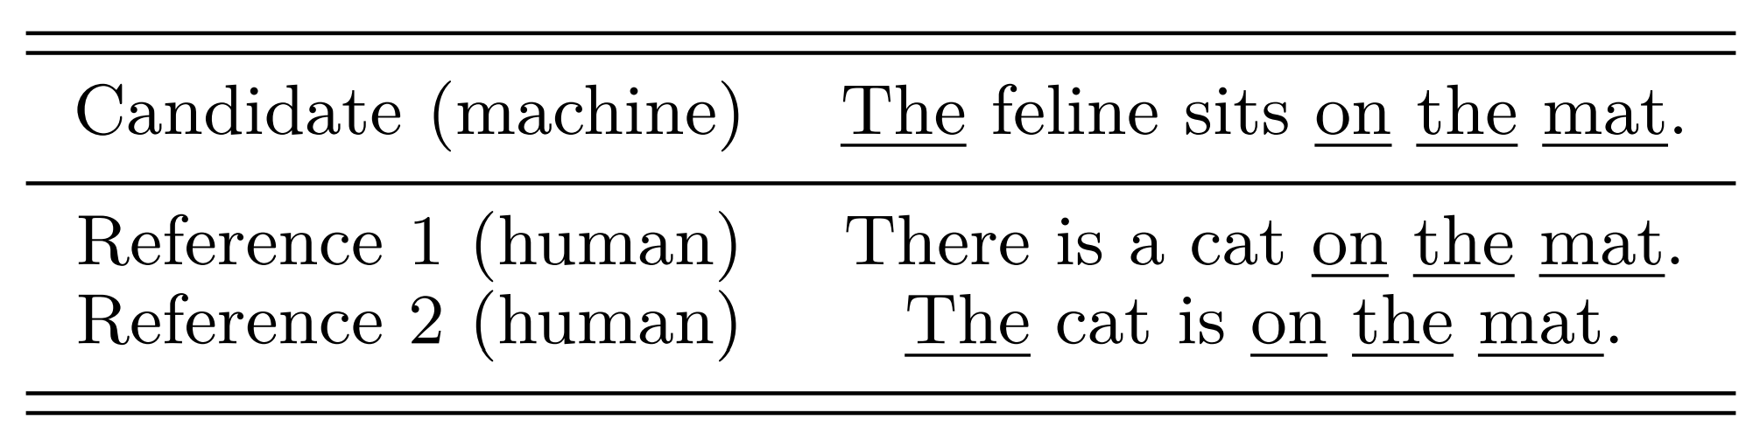
Multiple reference translations are allowed
What is the BLUE score of the candidate translation?

Slide 12
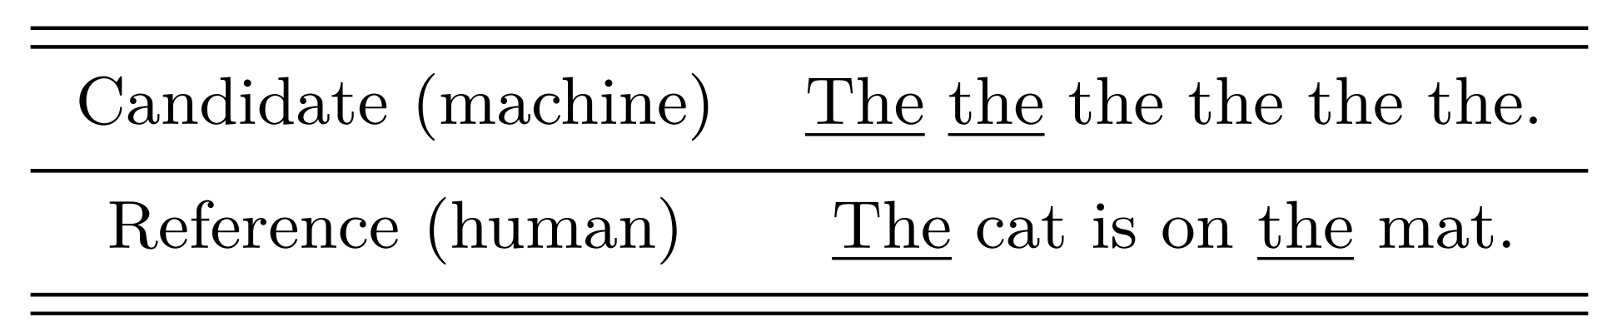
Avoiding metric abuse
BLEU allows each word from a reference translation to be used just once!
What is the BLUE score of the candidate translation?

Slide 13
LSTM-based encoder-decoder architectures

Slide 14
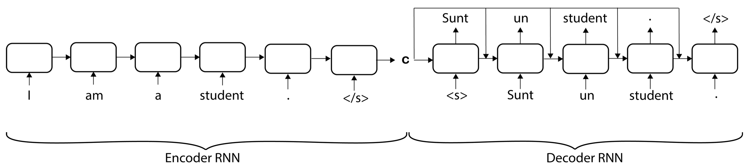
Architecture
<s> - start of sentence
</s> - end of sentence
c encodes the input text. This embedding is used to generate every output token.

Slide 15
Architecture
We first encode the input sequence (i.e., the text in the source language), using an RNN such as a left-to-right LSTM. The hidden state of the last word in the input text, i.e., the c vector produced for the </s> token in the figure, becomes the representation of the entire input.
Starting from this representation, we then generate (or decode) one word at a time from the target language using a second RNN.
Each decoder cell receives the following inputs:
the input embedding of the previously decoded word (e.g., the embedding of the word Sunt for the cell that decodes un)
the hidden state of the previous RNN cell, which is combined with the encoding of the input text c (e.g., through concatenation). Thus, each decoding cell “knows” where it stands in the currently decoded text, as well as what the representation of the source text is.
Decoding continues until the stop symbol (</s>) is generated for the target text. Importantly, the decoded text does not need to have the same length as the input text.

Slide 16
Training
This entire architecture is trained to maximize the accuracy of the decoded text.
That is, each cell in the decoding RNN is encouraged to produce the correct target word at that position from the vocabulary of the target language.
More formally, the overall loss function is the sum of multiple cross entropy losses, one for each word in the gold target sequence.

Slide 17
Sounds simple, but…
Several tricks were needed to make it really work

Slide 18
Tricks (1/2)
Reverse the input sequence, e.g., “. student a am I”. Why?
Use two different LSTMs that do not share parameters: one for the encoder, and one for the decoder. Why?
Use stacked (or deep) LSTMs with four layers, each generating hidden state vectors of dimension 1,000, for both encoder and decoder. Why?

Slide 19
Tricks (2/2)
Use beam search, i.e., maintain top B predictions for each token position. Why?
Use an ensemble of five different instantiations of their system, where each of these instances is trained using a different random number generator, which changes the initialization of the network parameters as well as the order in which they process the data during training.
Same beam search strategy, but the predictions come from different models

Slide 20
Transformer-based encoder-decoder architectures

Slide 21
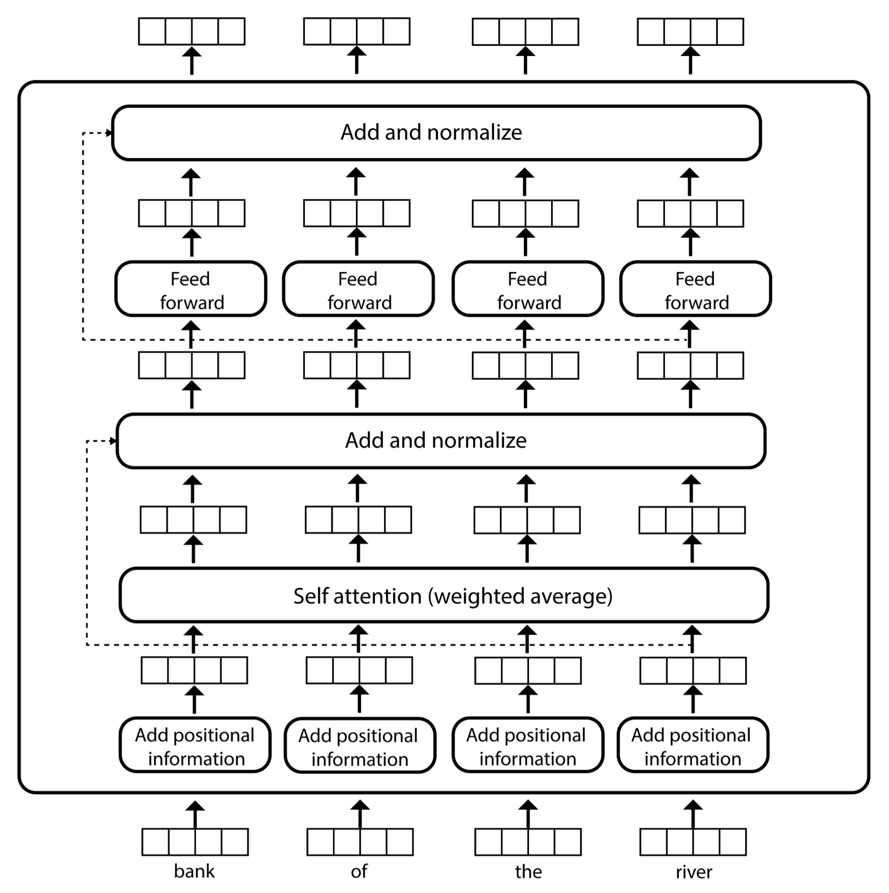
Reminder: encoder layer architecture

Slide 22
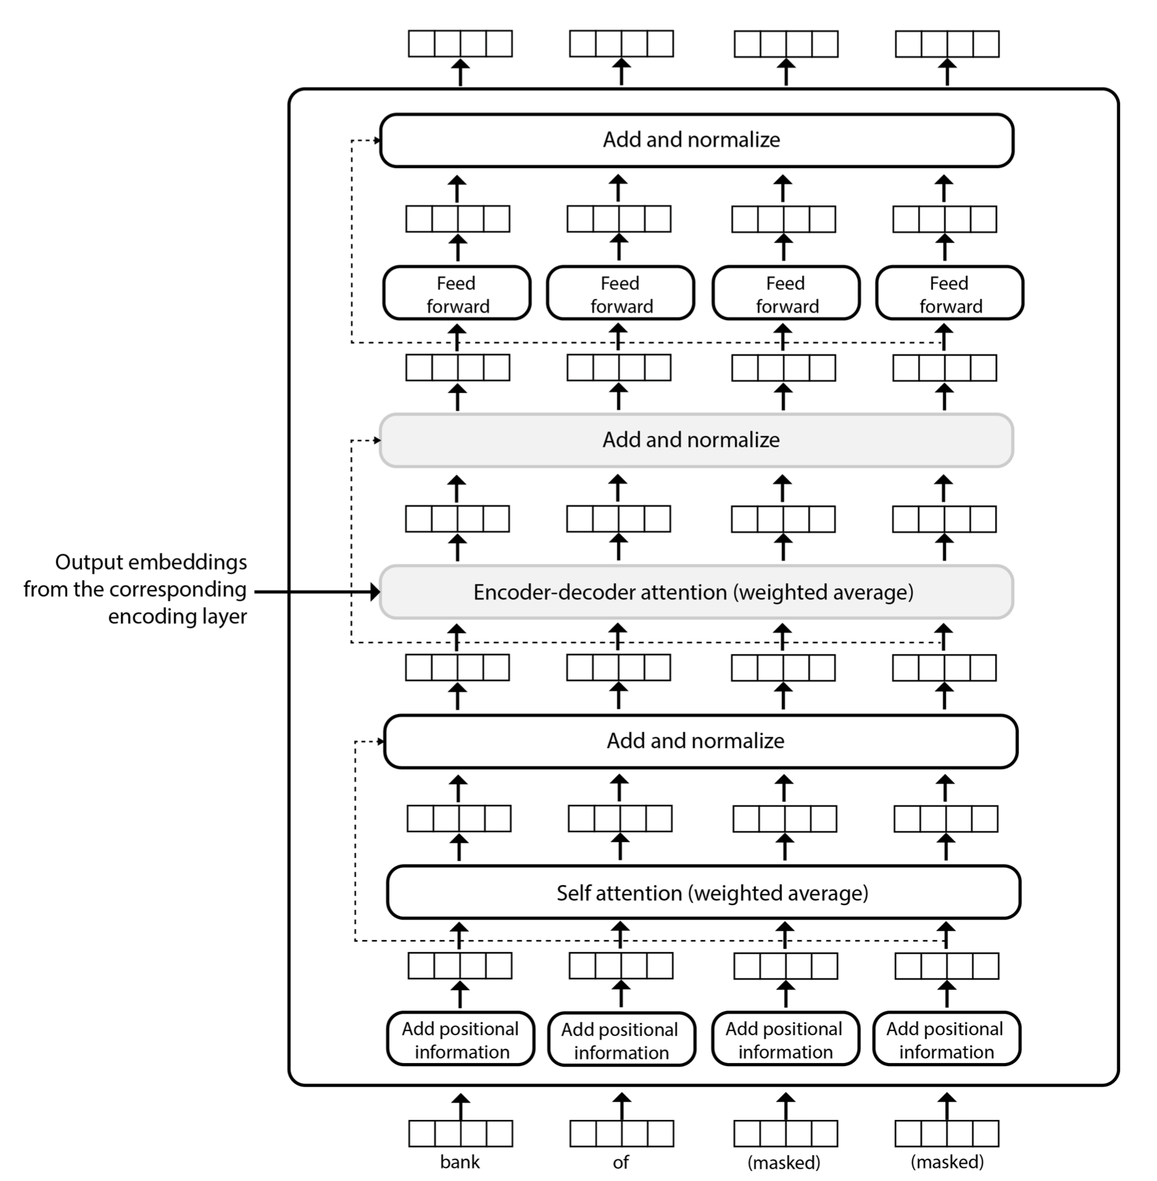
Decoder layer architecture
Attention over encoder embeddings
Can’t attend over tokens that have not been generated yet!

Slide 23
Three types of attention!
Encoder self-attention: see chapter 12
Decoder self-attention
Exactly the same math as the encoder self-attention, but
The decoder only has information about the words decoded so far. All other token placeholders are masked.

Slide 24
Three types of attention!
Encoder-decoder attention
Same math as the previous self-attention components, but
The query vector q_{i} is computed using the representation produced by the decoder for the word at position i, and
The key and value vectors k_{j} and v_{j} are computed using the output embedding z_{j} produced by the corresponding encoding layer for the input token at position j

Slide 25

Visualizing all attention weights

Slide 26
Drawbacks of encoder-decoder methods
Models are large, easily in the hundreds of billions of parameters
They are slow due to their attention mechanism, which is usually quadratic in the length of the texts.
The situation is exacerbated for encoder-decoder methods, which have two transformer networks, one for the encoder and one for the decoder, and three attention mechanisms
An equity concern!
They require parallel texts for training
What about low-resource languages?

Slide 27
Take away
Evaluation measure (BLUE)
The first sequence-to-sequence architecture using LSTMs
Sequence-to-sequence with attention
Transformer-based encoder-decoder architectures

